Slide 1
Artificial Intelligence
Dr. Bidush Kumar Sahoo
G.I.E.T. University,
Gunupur, Odisha

Slide 2
LEVEL OF THE AI MODEL
In the first Level attempt to solve problems that a computer can easily solve and do not usually use AI techniques.
AI techniques usually include a search, as no direct method is available, the use of knowledge about the objects involved in the problem area and abstraction on which allows an element of pruning to occur and to enable a solution to be found in real time; otherwise, and the data could explode in size. Examples of these trivial problems in the first class, which are now of interest only to psychologists are EPAM (Elementary Perceiver and Memorizer) which memorized garbage syllables.
The second Level of problems attempts to solve problems that are non-trivial for a computer and use AI techniques.
We wish to model human performance on these:
To test psychological theories of human performance. Ex. PARRY [Colby, 1975] – a program to simulate the conversational behavior of a paranoid person.
To enable computers to understand human reasoning – for example, programs that answer questions based upon newspaper articles indicating human behavior.
To enable people to understand computer reasoning. Some people are reluctant to accept computer results unless they understand the mechanisms involved in arriving at the results.
To exploit the knowledge gained by people who are best at gathering information. Examples of this type of approach led to GPS (General Problem Solver).

Slide 3
What is Problem?
Problem solving is a process of generating solutions from observed data.
a ‘problem’ is characterized by a set of goals, a set of objects, and a set of operations. These could be ill-defined and may evolve during problem solving.
A ‘problem space’ is an abstract space. A problem space is represented by a directed graph, where nodes
represent search state and paths represent the operators applied to change the state.
➢ A problem space encompasses all valid states that can be generated by the application of any combination of operators on any combination of objects.
➢ The problem space may contain one or more solutions. A solution is a combination of operations and
objects that achieve the goals.
➢ A ‘search’ refers to the search for a solution in a problem space.
➢ Search proceeds with different types of ‘search control strategies’.
➢ The depth-first search and breadth-first search are the two common search strategies.

Slide 4
What is Problem? Contd..
To build a system to solve a particular problem, we need to:
➢ Define the problem precisely – find input situations as well as final situations for an acceptable solution to the problem
➢ Analyze the problem – find few important features that may have impact on the appropriateness of various possible techniques for solving the problem
➢ Isolate and represent task knowledge necessary to solve the problem
➢ Choose the best problem-solving technique(s) and apply to the particular problem
Problem definitions
A problem is defined by its ‘elements’ and their ‘relations’. To provide a formal description of a problem, we need to do the following:
➢ Define a state space that contains all the possible configurations of the relevant objects, including some impossible ones.
➢ Specify one or more states that describe possible situations, from which the problem- solving process may start. These states are called initial states.
➢ Specify one or more states that would be acceptable solution to the problem. These states are called goal states

Slide 5
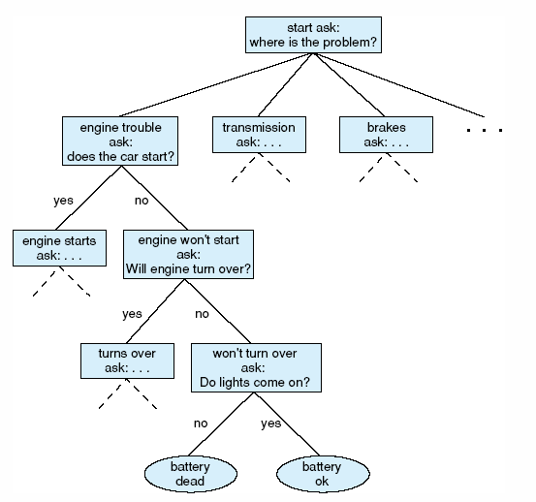
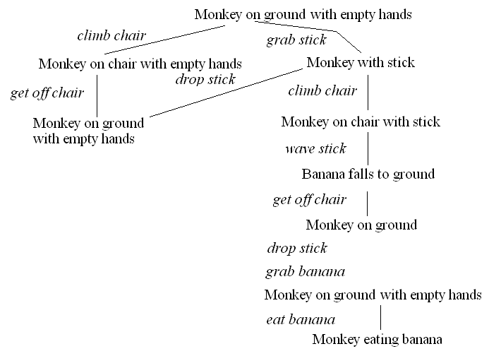
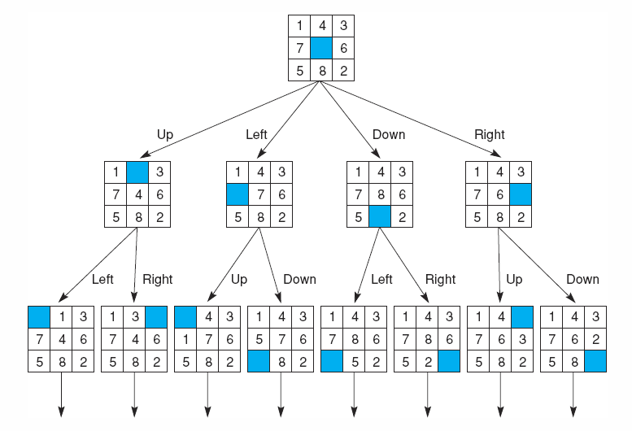
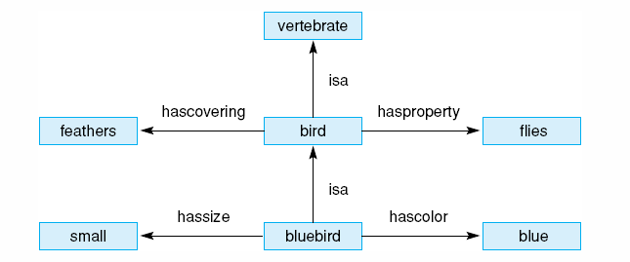

Slide 6
PROBLEM CHARACTERISTICS
Decomposability of the problem into a set of independent smaller subproblems
Possibility of undoing solution steps, if they are found to be unwise
Predictability of the problem universe
Possibility of obtaining an obvious solution to a problem without comparison of all other possible solutions
Type of the solution: whether it is a state or a path to the goal state
Role of knowledge in problem solving
Nature of solution process: with or without interacting with the user

Slide 7
Production System in AI
A production system (popularly known as a production rule system) is a kind of cognitive architecture that is used to implement search algorithms and replicate human problem-solving skills. This problem-solving knowledge is encoded in the system in the form of little quanta popularly known as productions. It consists of two components: rule and action.
Rules recognize the condition, and the actions part has the knowledge of how to deal with the condition. In simpler words, the production system in AI contains a set of rules which are defined by the left side and right side of the system. The left side contains a set of things to watch for (condition), and the right side contains the things to do (action).

Slide 8
Features of a Production System
A production system has the following features:
Simplicity: Due to the use of the IF-THEN structure, each sentence is unique in the production system. This uniqueness makes the knowledge representation simple to enhance the readability of the production rules.
Modularity: The knowledge available is coded in discrete pieces by the production system, which makes it easy to add, modify, or delete the information without any side effects.
Modifiability: This feature allows for the modification of the production rules. The rules are first defined in the skeletal form and then modified to suit an application.
Knowledge-intensive: As the name suggests, the system only stores knowledge. All the rules are written in the English language. This type of representation solves the semantics problem.

Slide 9
Production System Characteristics
Monotonic Production System: It’s a production system in which the application of a rule never prevents the later application of another rule, which could have also been applied at the time the first rule was selected.
Partially Commutative Production System: It’s a type of production system in which the application of a sequence of rules transforms state X into state Y, then any permutation of those rules that is allowable also transforms state x into state Y. Theorem proving falls under the monotonic partially communicative system.
Non-Monotonic Production Systems: These are useful for solving ignorable problems. These systems are important from an implementation standpoint because they can be implemented without the ability to backtrack to previous states when it is discovered that an incorrect path was followed. This production system increases efficiency since it is not necessary to keep track of the changes made in the search process.
Commutative Systems: These are usually useful for problems in which changes occur but can be reversed and in which the order of operation is not critical. Production systems that are not partially commutative are useful for many problems in which irreversible changes occur, such as chemical analysis. When dealing with such systems, the order in which operations are performed is very important and hence correct decisions must be made at the first attempt itself.

Slide 10
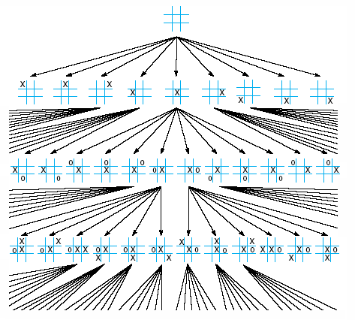
What is Search?
We define the state of the problem being solved as the values of the active variables
  this will include any partial solutions, previous conclusions, user answers to questions, etc
    while humans are often able to make intuitive leaps, or recall solutions with little thought, the computer must search through various combinations to find a solution
To the right is a search space for a tic-tac-toe game

Slide 11
Search Spaces and Types of Search
The search space consists of all possible states of the problem as it is being solved
  A search space is often viewed as a tree and can very well consist of an exponential number of nodes making the search process intractable
  Search spaces might be pre-enumerated or generated during the search process
  Some search algorithms may search the entire space until a solution is found, others will only search parts of the space, possibly selecting where to search through a heuristic
Search spaces include
  Game trees like the tic-tac-toe game
  Decision trees (see next slides)
  Combinations of rules to select in a production system
  Networks of various forms (see next slides)
  Other types of spaces

Slide 12
Issues in the Design of Search Programs
Each search process can be considered to be a tree traversal. The object of the search is to find a path from the initial state to a goal state using a tree. The number of nodes generated might be huge; and in practice many of the nodes would not be needed. The secret of a good search routine is to generate only those nodes that are likely to be useful, rather than having a precise tree. The rules are used to represent the tree implicitly and only to create nodes explicitly if they are actually to be of use.
The following issues arise when searching:
The tree can be searched forward from the initial node to the goal state or backwards from the goal state to the initial state.
To select applicable rules, it is critical to have an efficient procedure for matching rules against states.
How to represent each node of the search process? This is the knowledge representation problem or the frame problem. In games, an array suffices; in other problems, more complex data structures are needed.
Finally in terms of data structures, considering the water jug as a typical problem do we use a graph or tree? The breadth-first structure does take note of all nodes generated but the depth-first one can be modified.

Slide 13
Search Algorithm Terminologies
Searching is a step by step procedure to solve a search-problem in a given search space. A search problem can have three main factors:
Search Space: Search space represents a set of possible solutions, which a system may have.
Start State: It is a state from where agent begins the search.
Goal test: It is a function which observe the current state and returns whether the goal state is achieved or not.
Search tree: A tree representation of search problem is called Search tree. The root of the search tree is the root node which is corresponding to the initial state.
Actions: It gives the description of all the available actions to the agent.
Transition model: A description of what each action do, can be represented as a transition model.
Path Cost: It is a function which assigns a numeric cost to each path.
Solution: It is an action sequence which leads from the start node to the goal node.
Optimal Solution: If a solution has the lowest cost among all solutions.

Slide 14
Properties of Search Algorithms
Following are the four essential properties of search algorithms to compare the efficiency of these algorithms:
Completeness: A search algorithm is said to be complete if it guarantees to return a solution if at least any solution exists for any random input.
Optimality: If a solution found for an algorithm is guaranteed to be the best solution (lowest path cost) among all other solutions, then such a solution for is said to be an optimal solution.
Time Complexity: Time complexity is a measure of time for an algorithm to complete its task.
Space Complexity: It is the maximum storage space required at any point during the search, as the complexity of the problem.

Slide 15
Types of search algorithms
Based on the search problems we can classify the search algorithms into uninformed (Blind search) search and informed search (Heuristic search) algorithms.
Uninformed/Blind Search
The uninformed search does not contain any domain knowledge such as closeness, the location of the goal. It operates in a brute-force way as it only includes information about how to traverse the tree and how to identify leaf and goal nodes. Uninformed search applies a way in which search tree is searched without any information about the search space like initial state operators and test for the goal, so it is also called blind search. It examines each node of the tree until it achieves the goal node.
It can be divided into five main types:
Breadth-first search,
Uniform cost search,
Depth-first search,
Iterative deepening depth-first search,
Bidirectional Search

Slide 16
Informed Search
Informed search algorithms use domain knowledge. In an informed search, problem information is available which can guide the search. Informed search strategies can find a solution more efficiently than an uninformed search strategy. Informed search is also called a Heuristic search.
A heuristic is a way which might not always be guaranteed for best solutions but guaranteed to find a good solution in reasonable time.
Informed search can solve much complex problem which could not be solved in another way. An example of informed search algorithms is a traveling salesman problem.
1. Greedy Search
2. A* Search

Slide 17
THANK YOU

